Slide 1
Front End Performance for the Common Man:
Practical Strategies to Speed Up Your Site

Slide 2
Who is this Guy Anyway?
12+ years HTML/CSS/JavaScript. My day job since 1999.
Consultant at Isobar, North America
PAST: Cramer, AdvisorTech, Freelance: Compete, Demandware, The Weekly Dig, Gillette, Museum of Science, Boston, PC Connection, State Street, Webex

Slide 3
What Are We Going To Talk About
  Practical techniques and strategies to enhance front end performance.
Notes:
The emphasis is on practical. I’m focusing on the ones I think are important and hopefully I’ll show you that a few of the suggestions out there are easier than you previously thought.

Slide 4
Core Ideas
“Fast sites mean users do more stuff”
http://dfst.us/2c
http://www.drunkenfist.com/304/2008/12/29/why-front-end-performance-matters-to-everyone/)
Milliseconds MATTER.
  10 x 100ms improvements = 1 second gained.
Front End Performance Is a State of Mind
Notes:
“Fast sites mean users do more stuff” Whatever your site or app is about, doing it as fast as possible encourages users to do more of it. Hopefully you’re sold on the idea that this stuff is valuable. I think it is and I think it’s valuable for anyone that publishes on the web. I wrote an article about this a couple of years ago. It still stands up, I think.
Front end Performance is a state of mind. Basically, if you want to make fast sites, the best way to do it is wrap it into everything you do. Always look for an angle

Slide 5
Charts/Statistics/Pretty Pictures/Numbers
  If you need to sell this stuff to clients/managers/stakeholders:
  http://www.phpied.com/the-performance-business-pitch/
Notes:
Stoyan Stefanov put together a great powerpoint with a bunch of charts and graphs about how faster sites can make you more $$ and increase user interaction. I point you there for all your “selling performance needs”

Slide 6
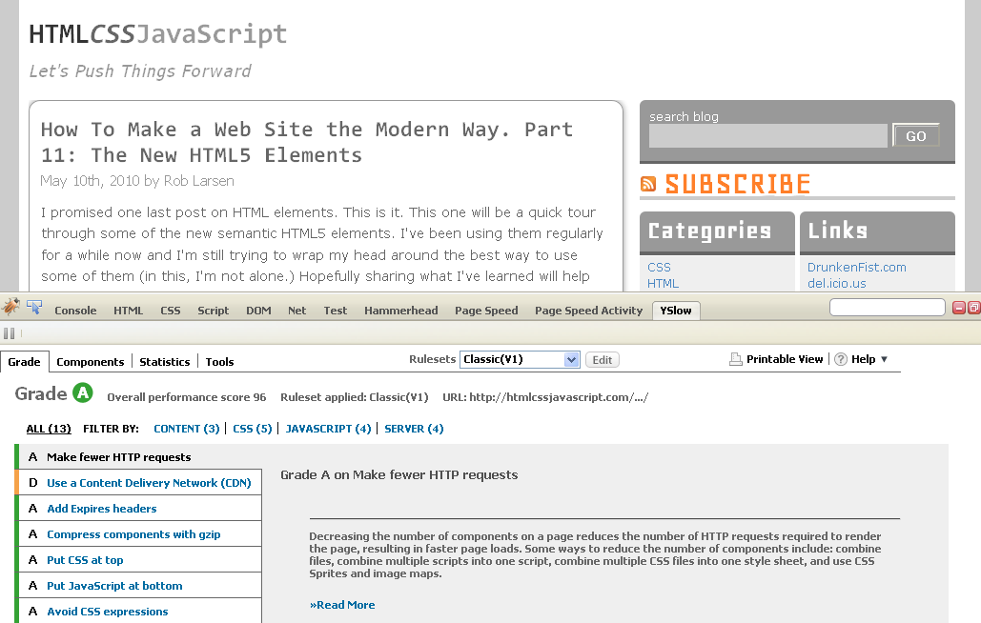
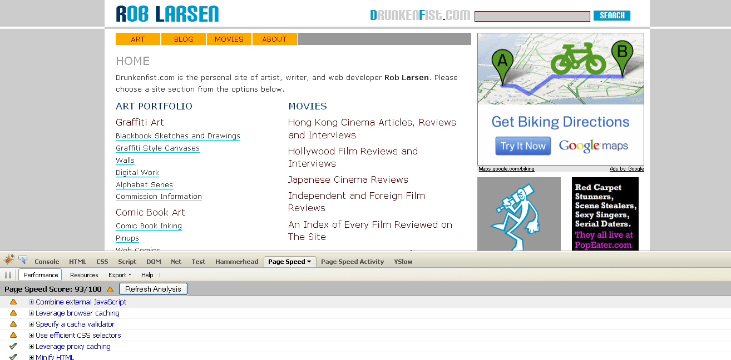
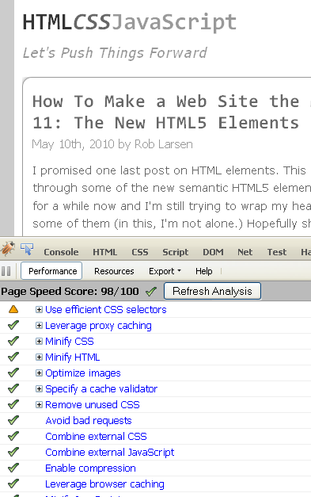
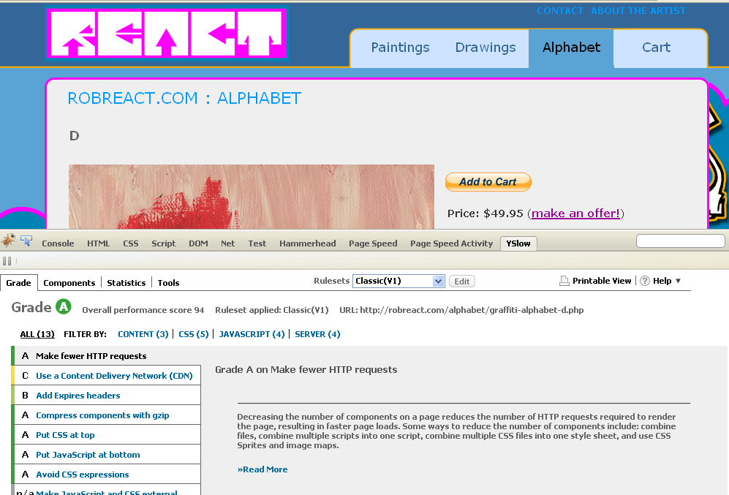
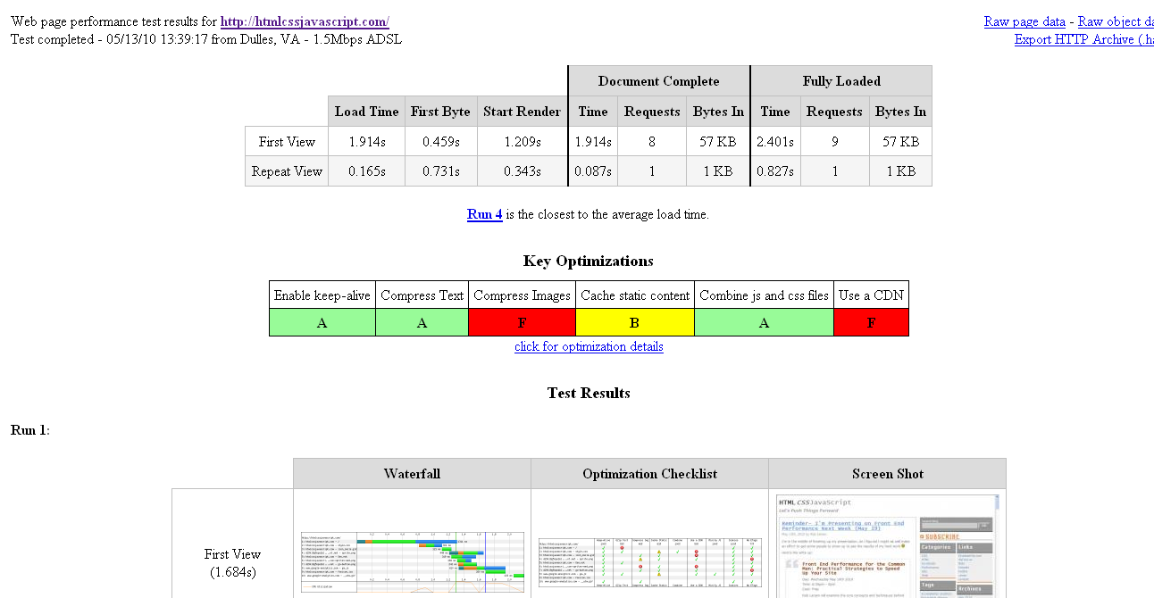
In Practice:
Notes:
HTMLCSSJavaScript.com
96-97 yslow
93-98 page speed
webpagetest (which is IE7, not the speediest browser) 1.914s first view , 0.165s with primed cache
robreact.com
90-94 yslow
93-96 page speed
1.291s for first view 0.495ms primed cache
DrunkenFist.com
70-75 Yslow (google ads are mostly to blame)
87 93 page speed
2.788s first view 1.247s cached (rich media ads)

Slide 7
Specifics
YSlow Rules
PageSpeed Rules
Some Random Notes to Get You Thinking
Notes:
We’re going to look at a few things today. We’re going to use some things you’re hopefully familiar with- the yslow rules and the pagespeed rules as a framework for our discussion. I’m going to go through and outline the ones I think are important or are a little trickier to implement. After that I’ll look at a couple of other notes, just a few things to think about while you’re building sites

Slide 8
YSlow Rules
Make Fewer HTTP Requests
Use a Content Delivery Network (CDN)
Add Expires or Cache-Control Header
Gzip Components
Put Stylesheets at Top
Put Scripts at Bottom
Avoid CSS Expressions
Make JavaScript and CSS External
Reduce DNS Lookups
Minify JavaScript and CSS
Avoid Redirects
Notes:
Make Fewer HTTP Requests
The biggest bottleneck in the browser (especially older IE browsers) is the connection limit. When you can only download two items in parallel limiting the number of items matters.
Use a Content Delivery Network (CDN)
Clear win here- speed and location optimized content is where it’s at.
Add Expires or Cache-Control Header
You want to leverage the browser cache (on the server side as well)
Reduce DNS Lookups
There’s a bit overhead with every new domain you’re connecting to
Minify JavaScript and CSS
Remove whitepsace and comments. In the case of JavaScript you can also shrink variable names down to save even more bytes

Slide 9

YSlow Rules
Remove Duplicate Scripts
Configure ETags
Make Ajax Cacheable
Flush Buffer Early
Use GET for Ajax Requests
Postload Components
Preload Components
Reduce the Number of DOM Elements
Split Components Across Domains
Minimize Number of iframes
Avoid 404s
Notes:
Postload components
Load only what you need and get the rest later
Preload Components
Where possible, grab what you need in advance
Split Components across Domains
To enhance performance in olderIE browsers especially, use a separate, cookieless domain or two for static components.

Slide 10
YSlow Rules
Reduce Cookie Size
Use Cookie-Free Domains for Components
Minimize DOM Access
Develop Smart Event Handlers
Choose <link> Over @import
Avoid Filters
Optimize Images
Optimize CSS Sprites
Do Not Scale Images in HTML
Make favicon.ico Small and Cacheable
Keep Components Under 25 KB
Notes:
Cookie free domains. Ever wonder why the big boys use domains like fbkcdn.com yimg.net, etc?
Optimize Images
It’s surprising how little attention is paid to the actual compression on images
Optimize CSS Sprites
Same goes for Sprites

Slide 11
YSlow Rules
Pack Components Into a Multipart Document
Avoid Empty Image src

Slide 12
PageSpeed Rules
Avoid bad requests
Avoid CSS expressions
Combine external CSS*
Combine external JavaScript*
Defer loading of JavaScript*
Enable compression*
Leverage browser caching*
Leverage proxy caching
Minify CSS*
Minify HTML
Minify JavaScript*
Notes:
Proxy caching is called out here specifically.
The rest of these are duplicated in the ySlow rules

Slide 13
PageSpeed Rules
Minimize request size
Minimize DNS lookups*
Minimize redirects
Optimize images*
Optimize the order of styles and scripts
Parallelize downloads across hostnames*
Put CSS in the document head
Remove unused CSS
Serve resources from a consistent URL
Serve scaled images
Serve static content from a cookieless domain*
Notes:
Optimize the order of styles and scripts
This is a tricky, uncommon use case, but one that’s pretty easy to deal with

Slide 14
PageSpeed Rules
Specify a character set early
Specify image dimensions
Use efficient CSS selectors
Notes:
Specify a character set early
An interesting little gotcha
Use efficient CSS selectors
This is a tough one.

Slide 15
The Big Ones
Make Fewer HTTP Requests
  Includes PageSpeed rules:
    Combine external CSS
    Combine external JavaScript
  Use CSS Sprites
Minify JavaScript and CSS
  Includes Duplicate PageSpeed rules
Notes:
If you’re going to do anything on these lists, this is a no-brainer. Reducing the amount of HTTP requests (and minifying CSS and JS while you’re at it) will get you’re the biggest bang for your buck- ESPECIALLY IN IE

Slide 16
Option A: Build Script
<?xml version="1.0"?>
<project name="Sample Build" default="build" basedir=".">
<property file="build.properties"/>
<property name="build.number" value="${build.number}"/>
<property name="build.cssdevpath" value="${build.cssdevpath}"/>
<property name="build.cssprodpath" value="${build.cssprodpath}"/>
<target name="current-number">
<echo>Current build number:${build.number}</echo>
</target>
<target name="rev">
<propertyfile file="build.properties">
<entry key="build.number" type="int" operation="+" value="1" pattern="000"/>
</propertyfile>
</target>
<target name="clean">
<delete dir="publish/"/>
</target>
Notes:
I like to use a build script for these tasks. Why? Well, it scales to every level of development, fits in with whatever language you’re using, it’s pretty easy to implement, it works with whatever static server solution you’re looking to implement (be it a CDN or a maybe an nginx server) and doesn’t ever tax the server (not that the hit there is all that much.)

Slide 17
Option A: Build Script
<target name="devclean">
<delete dir="dev/"/>
</target>
<target name="copy" >
<copy todir="publish">
<fileset dir="src">
<exclude name="_assets/styles/*.css"/>
<exclude name="_assets/scripts/*.js"/>
</fileset>
</copy>
</target>
<target name="devcopy" >
<copy todir="dev">
<fileset dir="src">
</fileset>
</copy>
</target>
<target name="devscripts">
<replace token="@@SCRIPTS@@" value="${build.jsdevpath}" file="dev/index.html" />
</target>
Notes:
I like to use a build script for these tasks. Why? Well, it scales to every level of development, fits in with whatever language you’re using, it’s pretty easy to implement, it works with whatever static server solution you’re looking to implement (be it a CDN or a maybe an nginx server) and doesn’t ever tax the server (not that the hit there is all that much.)

Slide 18
Option A: Build Script
<target name="scripts">
<concat destfile="publish/_assets/scripts/${build.number}.js">
<fileset file="src/_assets/scripts/jquery-1.4.2.js" />
<fileset file="src/_assets/scripts/base.js" />
</concat>
<apply executable="java" parallel="false">
<fileset dir="publish/_assets/scripts/" includes="${build.number}.js"/>
<arg line="-jar"/>
<arg path="tools/yuicompressor-2.4.2.jar"/>
<srcfile/>
<arg line="-o"/>
<mapper type="glob" from="${build.number}.js" to="publish/_assets/scripts/min-${build.number}.js"/>
<targetfile/>
</apply>
<replace token="@@SCRIPTS@@" value="${build.jsprodpath}" file="publish/index.html" />
<replace token="@@JSFILE@@" value="min-${build.number}" file="publish/index.html" />
<delete file="publish/_assets/scripts/${build.number}.js"/>
</target>
<target name="devcss">
<replace token="@@STYLES@@" value="${build.cssdevpath}" file="dev/index.html" />
</target>
Notes:
Theoretically you could grab the latest version of jQuery, build THAT and then include it in your script.

Slide 19
Option A: Build Script
<target name="css">
<concat destfile="publish/_assets/styles/${build.number}.css">
<fileset file="src/_assets/styles/screen.css" />
<fileset file="src/_assets/styles/home.css" />
</concat>
<apply executable="java" parallel="false">
<fileset dir="publish/_assets/styles/" includes="${build.number}.css"/>
<arg line="-jar"/>
<arg path="tools/yuicompressor-2.4.2.jar"/>
<srcfile/>
<arg line="-o"/>
<mapper type="glob" from="${build.number}.css" to="publish/_assets/styles/min-${build.number}.css"/>
<targetfile/>
</apply>
<replace token="@@STYLES@@" value="${build.cssprodpath}" file="publish/index.html" />
<replace token="@@CSSFILE@@" value="min-${build.number}" file="publish/index.html" />
<delete file="publish/_assets/styles/${build.number}.css"/>
</target>
<target name="dev" depends="devclean,devcopy,devscripts,devcss" description="builds a development build." ></target>
<target name="build" depends="current-number,clean,rev,copy,scripts,css" description="Concats files, runs YUI Compressor on them and makes magic happen." ></target>
</project>

Slide 20
Option A: Build Script
Download and mess around:
http://ant.apache.org/
http://dfst.us/build (http://htmlcssjavascript.com/downloads/build-sample.zip)
Clearly you can use your build system of choice, the concepts remain the same.

Slide 21
Option B: Over the Wire
PHP
  Minify
  Combine
  SmartOptimizer
Django
  Django Static Management
  Django compressor
Ruby
  Sprockets
  Juicer
  Jammit
  AssetPackager
.Net
  YUI Compressor for .Net
  Packer for .NET
Thanks- http://robertnyman.com/2010/01/19/tools-for-concatenating-and-minifying-css-and-javascript-files-in-different-development-environments/
Notes:
This is cool, but as a front end dev you have less control of how it’s done and it’s tougher to test early on in the development cycle.

Slide 22
Option C: Live the Dream (Manual)
Work in single files.
Minify by hand on the command line or online (http://yui.2clics.net/)
Rev file names by hand.
Leverage Google/Yahoo Ajax CDN if you want to keep library/app code separate.
Notes:
Not the worst method, if you’re working alone and don’t do a bunch of revisions.
Using the CDNs adds another DNS lookup, but you might feel like that’s a better solution than copying and pasting a library into a single file.

Slide 23
YUI Compressor
I like YUI Compressor
Some others:
/packer/
Dojo shrinksafe
Closure Compiler
CSSMin*
Notes:
Whatever method you use, I like YUI Compressor. It can be customized in several different ways, it deals well with conditional compilation and handles CSS, all from the same JAR.
CSSMin is buggy, but awesome
“Specifically, my CSS minifier will perform the following transformations on the file:
All comments are removed.
The properties within all selectors are ordered alphabetically.
The values for all properties are ordered alphabetically.
All unnecessary whitespace is removed.
“
You can actually train yourself to do this kind of thing. If you use the same patterns over and over again (think css shorthand) in your code it becomes second-nature and you help gzip

Slide 24
Sprites
I build them as I go
  8bit PNG (interface images, icons)
    watch the colors in the palette as you go. As you get closer to 256 time to start testing against the original
  JPG or 32bit PNG
  Watch not just file size (KB) but full memory footprint. 1500px x 1500px x 32bit = you’re doing it wrong.
Alternatively:
http://spriteme.org/
Notes:
Spriteme still takes some work, but if you’re not savvy to the ways of sprites it’s a great help

Slide 25


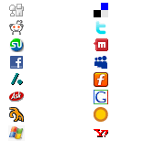

Sprites
Notes:
Some examples. The best example, because of their aspect ratio and limited palette might be the it’s all just comics one and the one from Drunkenfist.com

Slide 26
Optimize CSS Sprites
Use horizontal rather than vertical organization (smaller file size.)
As I mentioned… combine similar colors
Remember, 2000 x 2000 means you’re doing it wrong. 100x100 image is 10 thousand pixels. 1000x1000 is 1 million pixels. Compressed the file size is one thing. The memory footprint (uncompressed and displayed in the browser) is another thing entirely.
http://htmlcssjavascript.com/performance/a-quick-examination-of-the-memory-and-perfomance-ramifications-of-css-sprite-dimensions/
Notes:
I wrote about this and did some testing. Look at the jump in memory footprint between the no icons version and the 1500 x 1500 x 32 bit image

Slide 27
Use a Content Delivery Network
The big solutions are expensive.
Amazon CloudFront to the rescue.
API access
Cloudberry Explorer
Bucket Explorer
Downside
CSS/JavaScript are tricky to serve gzipped
Notes:
With cloudfront you have to write the headers and gzip files programmatically before you put them up on the server. Ouch.

Slide 28
Use a Content Delivery Network
Sprite, served off app server:
  Avg. Response Time
    233 ms
  Slowest avg. response time
    270 ms
  Fastest avg. response time
    211 ms

Slide 29
Use a Content Delivery Network
Sprite, served off app server:
  Avg. Response Time
    144 ms (shaves 40%)
  Slowest avg. response time
    243 ms
  Fastest avg. response time
    122 ms

Slide 30
Add Expires or Cache-Control Header
Page Speed Rules:
Leverage browser caching
Leverage proxy caching
So, yeah, this is why we need to rev file names

Slide 31
Add Expires
# most people will place this in .htaccess
# also in apache conf
ExpiresActive On
# enable expirations “A” = from access time (in seconds)
# 1 year, by the way
ExpiresByType image/x-icon A29030400
ExpiresByType application/x-javascript A29030400
ExpiresByType text/css A29030400
ExpiresByType image/gif A29030400
ExpiresByType image/png A29030400
ExpiresByType image/jpeg A29030400
# More readable format:
# ExpiresByType text/html "access plus 1 month 15 days 2 hours"

Slide 32
Cache-Control Header / Leverage Proxy Caching
<FilesMatch "\.(ico|pdf|flv|jpg|jpeg|png|gif|js|css|swf)$">
Header set Cache-Control "max-age=290304000, public"
</FilesMatch>
Notes:
I use the regular expires syntax because I’d rather deal with mime types. I don’t like the file name matching. Still, this allows you to explicitly say “this is publicly cacheable. Save it on your proxy server.”

Slide 33
Add Expires or Cache-Control Header
I don’t know anything about IIS. Microsoft says this:
User Interface
To use the UI Open IIS Manager and navigate to the level you want to manage. For information about opening IIS Manager, see Open IIS Manager (IIS 7). For information about navigating to locations in the UI, see Navigation in IIS Manager (IIS 7).
In Features View, double-click HTTP Response Headers.
On the HTTP Response Headers page, in the Actions pane, click Set Common Headers.
In the Set Common HTTP Response Headers dialog box, select the Expire Web content check box and select one of the following options:
  Select Immediately if you want content to expire immediately after it is sent in a response.
  Select After if you want the content to expire periodically. Then, in the corresponding boxes, type an integer and select a time interval at which content expires. For example, type 1 and select Days if you want the content to expire daily.
  Select On (in Coordinated Universal Time (UTC)) if you want the content to expire on a specific day and at a specific time. Then, in the corresponding boxes, select a date and time at which the content expires.
Click OK.
(http://technet.microsoft.com/en-us/library/cc770661%28WS.10%29.aspx )

Slide 34
Add Expires on CloudFront/S3
I wrote this up, in depth:
http://www.drunkenfist.com/304/2007/12/26/setting-far-future-expires-headers-for-images-in-amazon-s3/
I actually keep this snippet on my desktop for just this reason:
“Sun, 22 Sep 2024 20:15:42 GMT”

Slide 35
Gzip Components
This one can be tricky depending on your level of control and your host’s idea of what’s cool.

Slide 36
Gzip Components
#straightforward, you have access to apache conf
LoadModule deflate_module modules/mod_deflate.so
<Directory “/var/www”>
AddOutputFilterByType DEFLATE text/css application/x-javascript
AddOutputFilterByType DEFLATE text/html text/plain text/xml
AddOutputFilterByType DEFLATE application/x-httpd-php
# this is complete legacy stuff. Watching out for Netscape 4!
BrowserMatch ^Mozilla/4 gzip-only-text/html
BrowserMatch ^Mozilla/4\.0[678] no-gzip
# MSIE masquerades as Netscape, but it is fine
BrowserMatch \bMSI[E] !no-gzip !gzip-only-text/html
# Make sure proxies don't deliver the wrong content
Header append Vary User-Agent env=!dont-vary
</Directory>

Slide 37
Gzip Components
If you don’t have access to your config and your host won’t allow you to turn it on from .htaccess, there’s still a way

Slide 38
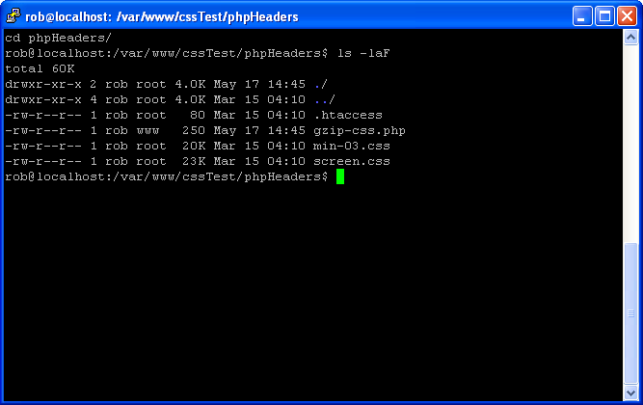
Gzip Components (PHP headers)

Slide 39
Gzip Components (PHP headers)
#contents of the htaccess file
# hey, if we’ve got a css file in this folder
#prepend this php file to it…
AddHandler application/x-httpd-php .css
php_value auto_prepend_file gzip-css.php

Slide 40
Gzip Components (PHP headers)
<?php
ob_start ("ob_gzhandler");
header("Content-type: text/css; charset: UTF-8");
header("Cache-Control: max-age=604800");
$offset = 604800 ;
$ExpStr = "Expires: " .
gmdate("D, d M Y H:i:s",
time() + $offset) . " GMT";
header($ExpStr);
?>

Slide 41
Gzip Components (PHP headers)
Even with invoking php, this is still significantly quicker than uncompressed text
http://htmlcssjavascript.com/samples/cssTest/phpHeaders/screen.css -277ms
http://htmlcssjavascript.com/samples/cssTest/screen.css - 134ms
Notes:
Hammerhead!

Slide 42
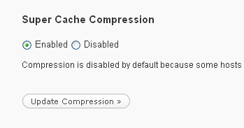
Gzip Components (the Wordpress Edition)
Wp-super-cache + super cache compression = yes
DO THIS
Notes:
Hammerhead!

Slide 43
Gzip Components
More Microsoft Stuff.
To enable global HTTP compression by using IIS Manager.
In IIS Manager, double-click the local computer, right-click the Web Sites folder, and then click Properties.
Click theService tab, and in the HTTP compression section, select the Compress application files check box to enable compression for dynamic files.
Select the Compress static files check box to enable compression for static files.
In the Temporary directory box, type the path to a local directory or click Browse to locate a directory. Once a static file is compressed, it is cached in this temporary directory until it expires, or the content changes. The directory must be on the local drive of an NTFS–formatted partition. The directory cannot be compressed or shared, and the access control lists (ACLs) for the directory must include Full Control access to the identity of the application pool or to the IIS_WPG group.
Under Maximum temporary directory size, click a folder size option. If you specify a maximum size under Limited to (in megabytes) (the default setting is 95 MB), then when the limit is reached, IIS automatically cleans up the temporary directory by applying the "least recently used" rule.
Click Apply, and then click OK.

Slide 44
Domain Sharding
Yslow Rules
  Reduce DNS Lookups
  Split Components Across Domains
  Use Cookie-Free Domains for Components
PageSpeed Rules:
  Parallelize downloads across hostnames
  Minimize DNS lookups
  Serve static content from a cookieless domain
Notes:
The difficulty is balancing the number of DNS lookups versus the benefits of domain sharding.

Slide 45
What I do
I use two or three domains I control and several that I don’t
  Main domain (including CSS and JS*)
  Interface images from Cloudfront
  Content images from media.drunkenfist.com
  Google beats me up with analytics and ad code (one example)
    www.google-analytics.com
    pagead2.googlesyndication.com
    googleads.g.doubleclick.net
    ads.pointroll.com
    spd.pointroll.com
    speed.pointroll.com

Slide 46
This matters less than it used to
http://www.browserscope.org/
http://www.stevesouders.com/blog/2008/03/20/roundup-on-parallel-connections/
Parallel Connections for the major browsers
 | HTTP/1.1 | HTTP/1.0
IE 6,7 | 2 | 6
IE 8 | 6 | 6
Firefox 1.5, 2 | 2 | 8
Firefox 3 | 6 | 6
Safari 3,4 | 4 | 4
Chrome | 6 | ?
Opera 9 | 4 | ?
Notes:
IE 6,7 are where this really matters. They will bottleneck.

Slide 47
Serve static content from a cookieless domain
“if your domain is www.example.org, you can host your static components on static.example.org. However, if you've already set cookies on the top-level domain example.org as opposed to www.example.org, then all the requests to static.example.org will include those cookies. “
this is why you see domains like:
  http://static.ak.fbcdn.net/
  http://l.yimg.com/
  http://www.gstatic.com
Notes:
There’s a bit of overhead with the cookies. No need to send that along when you’re just serving up some static files.

Slide 48
Postload Components
PageSpeed Rule:
  Defer loading of JavaScript
No easy answers-
  Analyze YOUR application to see where you might be able to split your code.
  The Profile deferrable JavaScript option in PageSpeed might help.
  LABjs
Notes:
Loading And Blocking JavaScript

Slide 49
Preload components
You can do it old-school, with JavaScript
Also rel=prefetch is awesome.

Slide 50
Rel=prefetch
<!—http://www.drunkenfist.com/art/graffiti-art/black-book/rt-graffiti-react-3d.php →
<link
rel="prefetch"
href="/art/graffiti-art/black-book/rt-graffiti-reactone.php"
/>
<link
rel="prefetch" href="http://media.drunkenfist.com/img/art/graffiti_art/black_book/rt_graffiti_reactone.gif”
/>
Notes:
This is a gallery page- it follows therefore to get the next image and php page in the gallery flow. My gallery pages are sooooper fast in Firefox because of this.

Slide 51
Optimize Images
Choose The Right Image Formats
Use JPGs for Photographs, Paintings, Etc.
  If it got smooth transitions from light to dark, has a ton of colors and/or generally looks "real" your best bet is to use a JPG. The P in JPG is for "Photographers" so it makes sense.
Use 8 Bit PNGs For Interface Images or Other Images With a Limited Number of Colors
  If it's got a limited number of colors (up to 256), I use an 8 bit PNG.
  I also output crisp black and white line art as 8 Bit PNGs:
Use 32 Bit PNGs For Images with Special Transparency or Opacity Needs
  These are larger file size (those bits come at a price,) so they can't be used everywhere, but they're really useful for special cases like this one.

Slide 52
Minimize DOM Access
While it’s all just JavaScript code, in the browser, there’s ECMAScriptLand and DOMLand. They’re connected, but separate. It’s inefficient to get from one to the other.
Limit the number of trips back and forth.
It helps to think of them as different spaces. Get what you need. Work on it in a safe place and then, when it’s ready, insert it back into the document.

Slide 53
Optimize Images
I use fireworks. I think it does a really nice job of optimizing images.
Also,
SMUSH.it!

Slide 54
Specify a character set early
I just wanted to call this out because it made me say “huh, of course…” when I read about it.
http://www.kylescholz.com/blog/2010/01/performance_implications_of_charset.html
Notes:
The browser will buffer content waiting for the correct character set. It’s more performant to do it in the HTTP headers, but if you must use the meta tag, make it as early as possible.

Slide 55
Optimize the order of styles and scripts
“Therefore, since stylesheets should always be specified in the head of a document for better performance, it's important, where possible, that any external JS files that must be included in the head (such as those that write to the document) follow the stylesheets, to prevent delays in download time. “
http://code.google.com/speed/page-speed/docs/rtt.html#PutStylesBeforeScripts
Notes:
I never really knew about this one until I started doing this presentation…

Slide 56
Use Efficient CSS Selectors
This one will drive you mental.
Really, you can potentially ignore it if you like. This is mostly an issue for applications with a very large number of DOM elements.
If you’ve got a large number of DOM elements… have fun!
This article is almost ten years old.
Notes:
How is it that we just started talking about this now? Maybe because we never had enough DOM elements for this to matter until recently? Still, I was having performance issues with large #s of DOM nodes in 2006. I can’t have been alone. I’m amazed this nugget has been buried.

Slide 57
Use Efficient CSS Selectors
The engine evaluates each rule from right to left, starting with the "key“ selector and moving through each selector until it finds a match or gives up
Less rules = better
Be as specific as possible
Avoid unnecessary redundancy
Don’t waste time with rules that don’t apply

Slide 58
Use Efficient CSS Selectors
Rules with descendant selectors For example:
    Rules with the universal selector as the key
      body * {...}
    Rules with a tag selector as the key
      ul li a {...}
For every element that matches the key the browser must go up the DOM tree testing every ancestor element until it matches or hits the root element

Slide 59
Use Efficient CSS Selectors
Rules with child or adjacent selectors
  body > * {...}
  .hide-scrollbars > * {...}
Rules with a tag selector as the key
  ul > li > a {...}
  #footer > h3 {...}
For each matching element, the browser has to test another node, either up (to a parent or over to a sibling.

Slide 60
Use Efficient CSS Selectors
Rules with overly qualified selectors
  nav#nav {...}
  form#login {...}
ID selectors are unique by definition. Adding a class just adds useless overhead
Rules that apply the :hover pseudo-selector to non-link elements
  h3:hover {...}
  .foo:hover {...}
The :hover pseudo-selector on non-anchor elements is known to make IE7 and IE8 slow in some cases*

Slide 61
Use Efficient CSS Selectors
This goes for JavaScript, too:
At least with Sizzle, QuerySelectorAll and YUI3

Slide 62
Other notes
Write Faster JavaScript (*duh*)
T-E-S-T your JavaScript/other techniques and share your results if you can
Prepare for an empty cache

Slide 63
Faster JavaScript
Sadly, this won’t be an in-depth tour through speeding up your scripting.
That’d be fun, but that’d be a whole other presentation.
Instead, I’m going to just give you a couple of things to think about as you do your thing.

Slide 64
Convenience is Awesome. Except When it’s not…
Libraries are awesome. Yes, awesome.
But, sometimes the convenience methods exposed by libraries will, by their very nature, slow your site down. That convenience is provided by code sitting between you and plain-old-javascript. That code is always going to present some overhead.

Slide 65
Convenience is Awesome. Except When it’s not…
The each/foreach method offered by all the major libraries is a great example of where it can be an actual problem. It’s 8x slower to use ech/foreach versus just using a traditional for loop. Normally, this isn’t actually a huge deal, but… it’s something to keep an eye on if you’re having performance woes.

Slide 66
Why’s that slow, BTW?
It creates, executes and destroys a new function every time through the loop
That adds a new level to the scope chain (which leads to longer identifier resolution) and creates a second activation object (one for the anonymous function, one for the containing function) Lots of overhead.
Curious about closures: http://www.jibbering.com/faq/notes/closures/
Notes:
An execution context is an abstract concept used by the ECMSScript specification (ECMA 262 3rd edition) to define the behaviour required of ECMAScript implementations. The specification does not say anything about how execution contexts should be implemented but execution contexts have associated attributes that refer to specification defined structures so they might be conceived (and even implemented) as objects with properties, though not public properties.
All javascript code is executed in an execution context. Global code (code executed inline, normally as a JS file, or HTML page, loads) gets executed in global execution context, and each invocation of a function (possibly as a constructor) has an associated execution context. Code executed with the eval function also gets a distinct execution context but as eval is never normally used by javascript programmers it will not be discussed here. The specified details of execution contexts are to be found in section 10.2 of ECMA 262 (3rd edition).
When a javascript function is called it enters an execution context, if another function is called (or the same function recursively) a new execution context is created and execution enters that context for the duration of the function call. Returning to the original execution context when that called function returns. Thus running javascript code forms a stack of execution contexts.
When an execution context is created a number of things happen in a defined order. First, in the execution context of a function, an "Activation" object is created. The activation object is another specification mechanism. It can be considered as an object because it ends up having accessible named properties, but it is not a normal object as it has no prototype (at least not a defined prototype) and it cannot be directly referenced by javascript code.
The next step in the creation of the execution context for a function call is the creation of an arguments object, which is an array-like object with integer indexed members corresponding with the arguments passed to the function call, in order. It also has length and callee properties (which are not relevant to this discussion, see the spec for details). A property of the Activation object is created with the name "arguments" and a reference to the arguments object is assigned to that property.

Slide 67

Also
http://www.yuiblog.com/blog/2010/04/21/video-hpjs/
Notes:
Pretty good book- and it’s short.
Video offers a taste.

Slide 68


T-E-S-T
And SHARE, if you can:
http://blogs.sun.com/greimer/entry/best_way_to_code_a
var i = arr.length; while (i--) {}
http://blog.stevenlevithan.com/archives/faster-trim-javascript
return str.replace(/^\s\s*/, '').replace(/\s\s*$/, '');
http://www.stevesouders.com/blog/

Slide 69
Cache
Never Assume the user will have ANYTHING in their cache
Seriously if Yahoo! Users have an empty cache 40-60% of the time, then what chance do we mortals have?
Don’t plan for the second page view at the expense of the first.
Notes:
NEVER EVER EVER EVER ASSUME a user will have anything you need in their cache. I’ve heard people say things like – who cares how much javascript I serve to the user- it’s all going tog et cached anyway. Sure, but only if they stick around through the first page load and decide your site is worth checking out.

Slide 70
Cache
Caches are freakin’ tiny:
  Internet Explorer: 8-50 MB
  Firefox: 50 MB
  Safari: everything I found said there isn’t a max size setting (???)
  Chrome: < 80 MB (varies depending on available disk space)
  Opera: 20 MB
  http://www.stevesouders.com/blog/2010/04/26/call-to-improve-browser-caching/

Slide 71
Tools
YSlow
Page Speed
Hammerhead
MSFast
PageTest
Fiddler
Pingdom
dynaTrace AJAX Edition
Google Speed Tracer

Slide 72
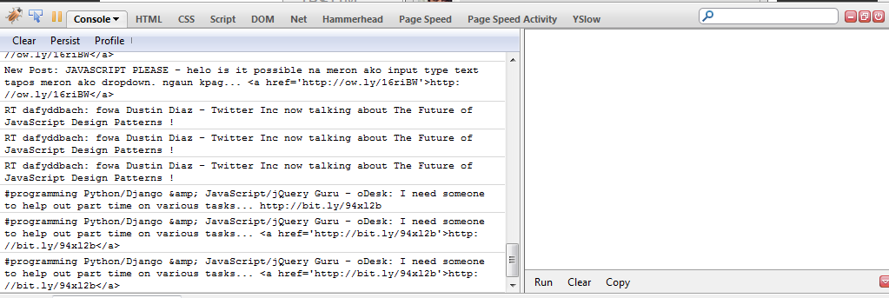
FireBug (f12)
Console

Slide 73
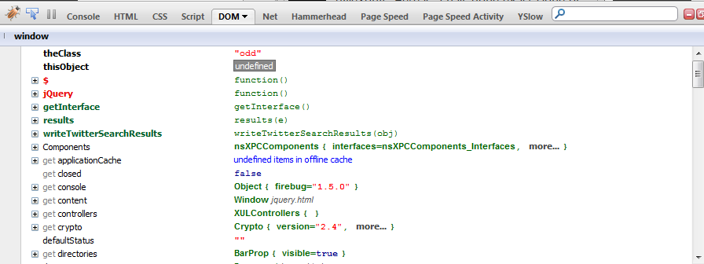
FireBug
DOM Inspector

Slide 74
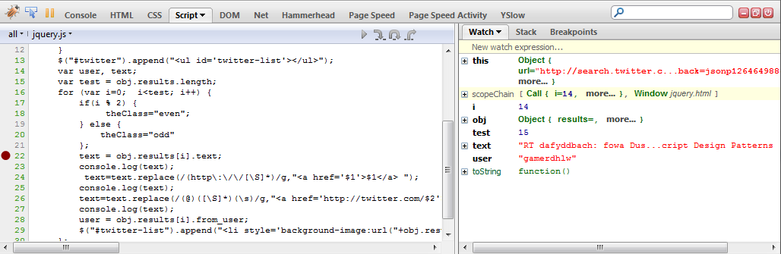
FireBug
Breakpoints
Notes:
The location in programming code that, when reached, triggers a temporary halt in the program. Programmers use breakpoints to test and debug programs by causing the program to stop at scheduled intervals so that the status of the program can be examined in stages.

Slide 75
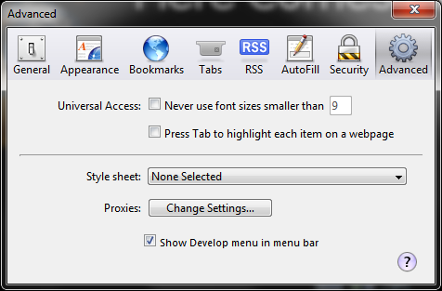
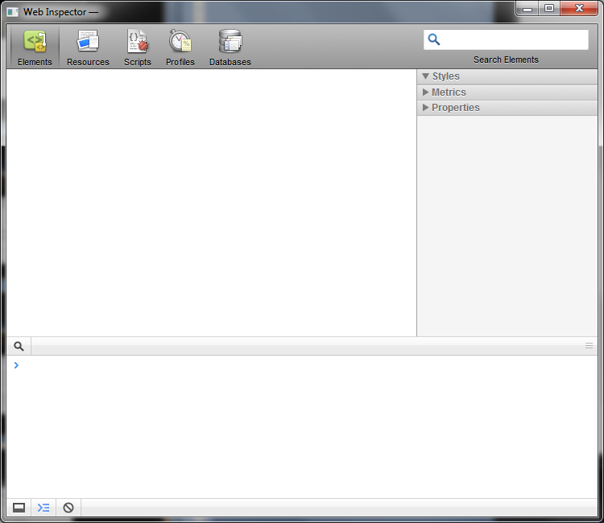
Safari (ctrl +alt + i)

Slide 76
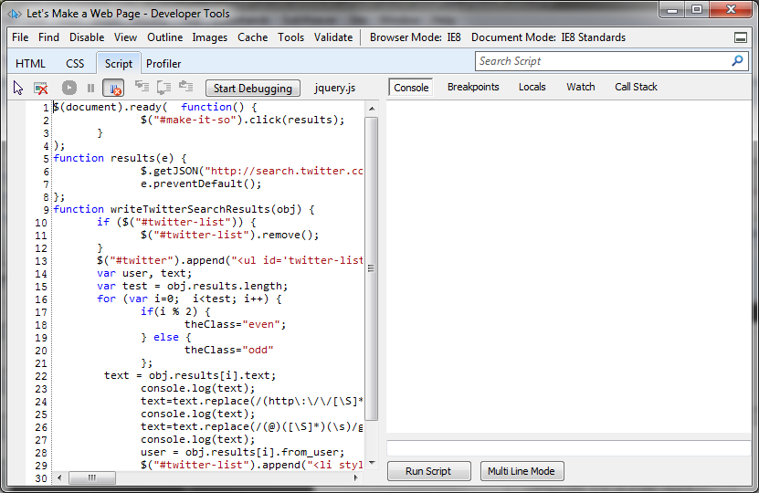
Internet Explorer 8 (f12)

Slide 77
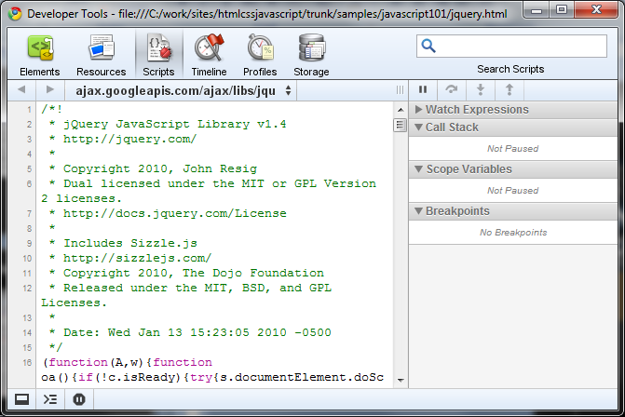
Chrome (ctrl + shft + j)

Slide 78


I’VE GOT STICKERS
THANKS!

